Slide 1
Design of a 16-bit RISC CPU
by group one

Slide 2
Architecture
RISC
MIPS
Harvard
Inspired by Intel 8086 processor

Slide 3
Design implementation
ALU
Register Banks
Control Unit
CPU

Slide 4
Instruction set format
The microprocessor instruction set is divided into 3 main parts
OpCode R1 R2 Immediate Instruction
/-------\ /-\ /-\ /------------------\
0 0 0 0 0 0 0 0 0 0 0 0 0 0 0 0

Slide 5
The assembler
The Assembler takes a file as input and generates a hex file ready to run
Avoids programming directly in machine language

Slide 6
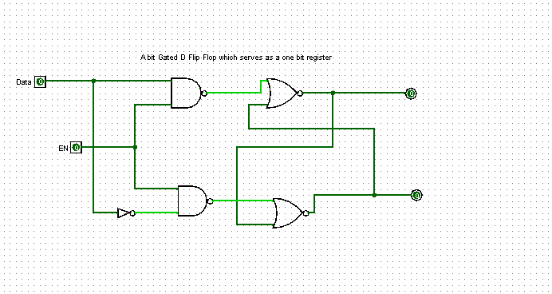
the register a single input data flip flop serving the core of a one bit register

Slide 7
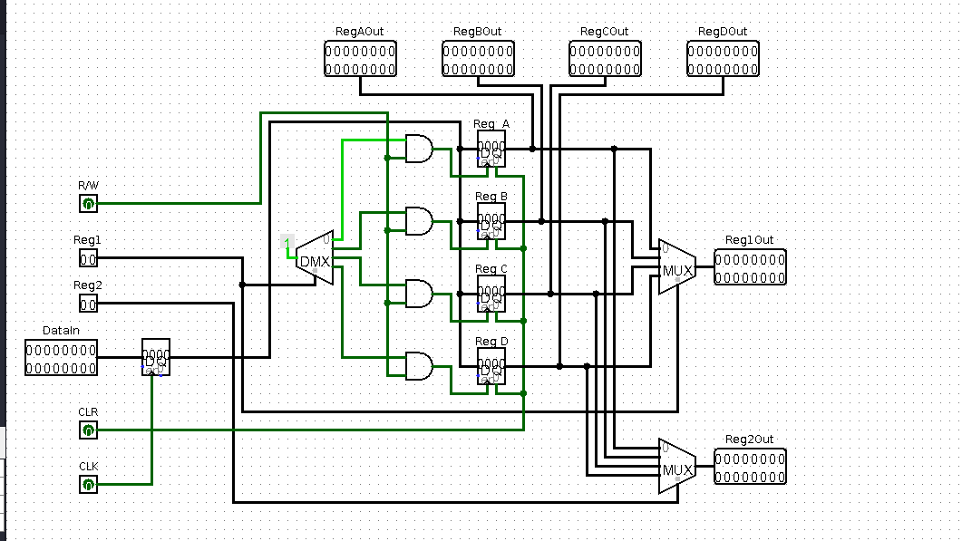
the rigester bank

Slide 8
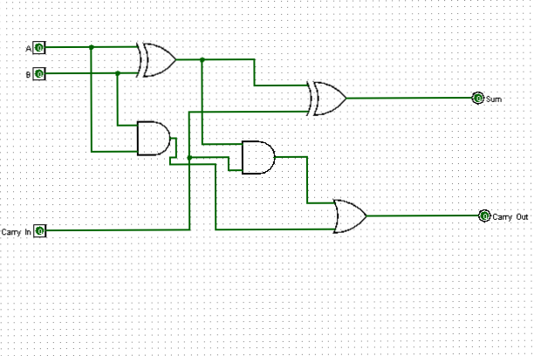
a gated one bit adder

Slide 9
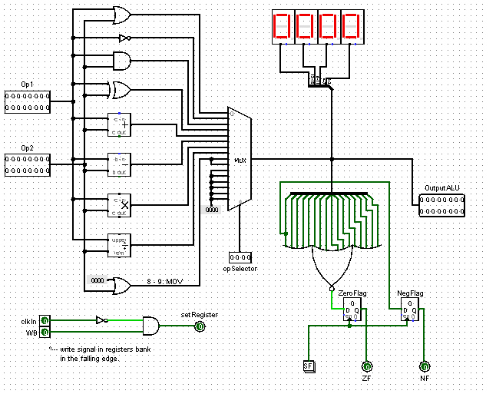
the alu

Slide 10
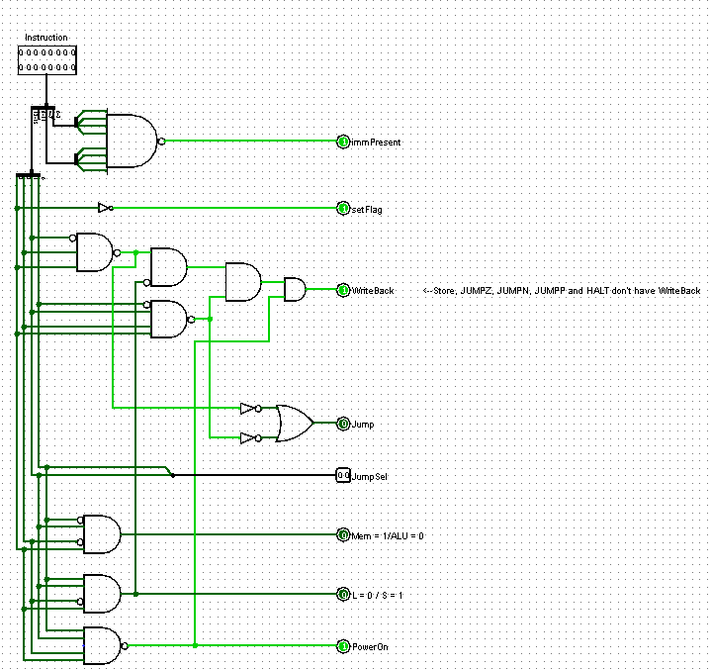
the control unit

Slide 11
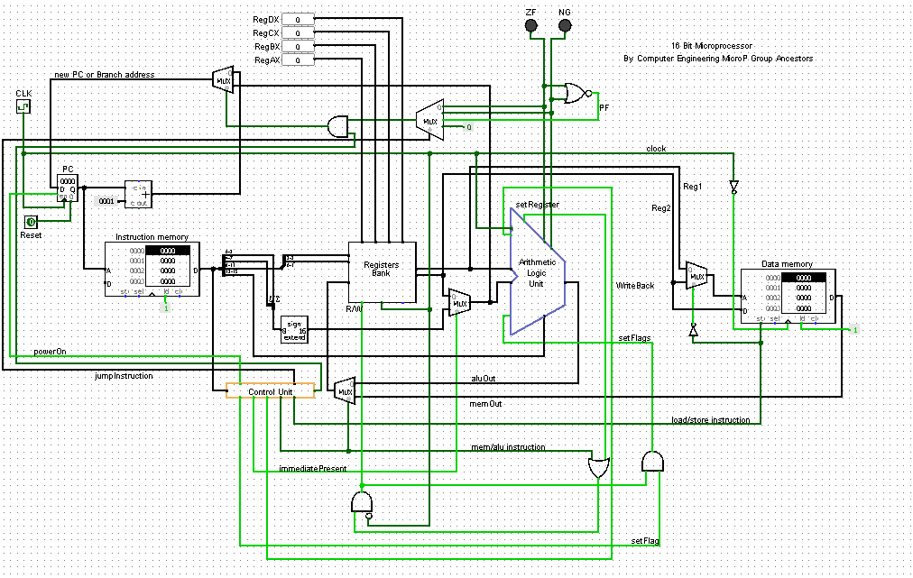
the full microprocessor and how it works

